Slide 1
Covid Tracker
Presenting solution for COVID-19
Team Name - Teslacoil
Team Members -
Shayan Chatterjee - shayanchatterjee7@gmail.com
Abhinandan Purkait- purkaitabhinanan@gmail.com
Sayantan Ghosh - gsayantan1999@gmail.com
Soujanna Dutta - soujanna2015newera@gmail.com

Slide 2
| Complete frontend of the website |
| Abhinandan Purkait | purkaitabhinandan@gmail.com | complete backend,integration of all modules in django, hosting |
| Sayantan Ghosh | gsayantan1999@gmail.com | Cleaning of gathered user data, implementation of all graphs and models |
| Soujanna Dutta | soujanna2015newera@gmail.com | Implementation of the graphs and models |

Slide 3
Table of Content
Introduction
Problem Statement
Our Approach - Cycle Diagram
Our Innovation
Tech Stack Used
Implementation - A brief Idea
Conclusion

Slide 4
Introduction
Coronavirus - The Invisible Killer
Currently , the world is grappling with an invisible, deadly enemy, trying to understand how to live with the threat posed by a virus. It has stretched around the world, it’s sparked a crop of diary entries and essays that describe how life has changed.
This is a pandemic, a global crisis and tragedy on a scale that’s hard to fathom.
There are a lot of new things for the public to learn — about the virus, controlling its spread, social distancing, treating the sick, and how our governments should react to this chaotic situation. It’s like we’ve all been dropped in to study for a test in a class that no one signed up for. It’s confusing and hard to process.

Slide 5
Problem Statement
Coronavirus (COVID-19) - the biggest pandemic of 21st century has hit people all over the world pretty badly. All sorts of activities have been hampered by this pandemic.
Developers have to devise a way out to help people all over the world. People have to be made aware of the present situation. They should know various symptoms of the disease and basic prevention against them.
Developers need to find a feasible solution against this invisible enemy. How public can be made more aware of the current situation, basic prevention and predicted results of COVID-19 in near future - programmers and developers need to find an answer to all these questions.

Slide 6
Our Approach - Cycle Diagram
We have developed a Web app using Django integrating a detailed Dashboard system along with a forecasting Model which could predict the spread of Covid19 and to prevent the spread of Covid19.
Covid19 Tracker has four phases of Operation.
04
Analysis of Covid19
Cluster Analysis
Covid19 impact on Global Scale as well as State Wise Analysis of India.
Cluster Formation for the most affected Countries and states in india.
Covid19
Tracker
01
03
Prevention & Cure Strategies
Building Forecast Prediction Model
Prevention and Cure Strategies to prevent Covid19
Future Spread Analysis using facebook Prophet Model.
02

Slide 7
Tech Stack Used
We will be going to make use of the following tools and technologies to build our application -
Python (Django)
SQLite3DB
Plotly Express
Folium
Prophet Model
6. JavaScript
7. jQuery
8. HTML/CSS

Slide 8
Implementation - A brief Idea
The whole idea of reaching out to the public all over the world is done in our project is through a web application. Here people can reach out and get information about various things related to COVID-19. A brief idea of our implementation is given below -
We gather informations from various reliable sources like WHO, ICCI, JHCU.
We used graphs and all sorts of visualisation using those data to help the spread of COVID-19 all over the world using tool like Plotly Express.
We focussed mainly on India. We added various information such as number of confirmed cases, active cases, recovered patients and number of deaths.
We added various symptoms and also included a visualisation depicting the same.

Slide 9
Implementation - A brief Idea (Contd.)
Various preventive measures are added to fight against the virus.
We also implemented and added a prediction model using fbprophet which can predict the number of deaths and confirmed patients due to COVID-19 over the next 100 days.
We implemented a chatbot in our web application through which people
can gather more informations and check their report of positivity on this
deadly virus.
All these functionalities are made using a Django Application and is integrated with the front-end of the website using HTML and JavaScript.
The UI of the web application is designed and made responsive using CSS, SCSS and framework like Bootstrap.
We have made sure that users have complete satisfaction using this website and have the complete knowledge and awareness needed.

Slide 10
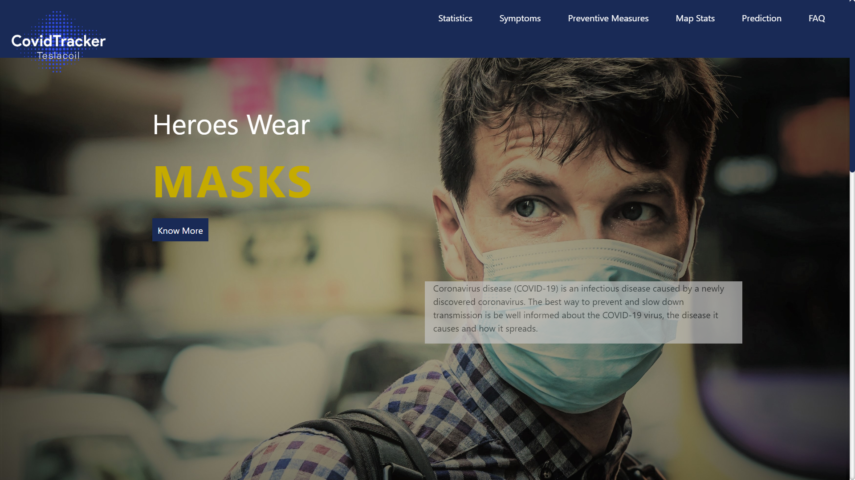
Application UI
Here is a snapshot of our web application that have been developed in desktop view.

Slide 11
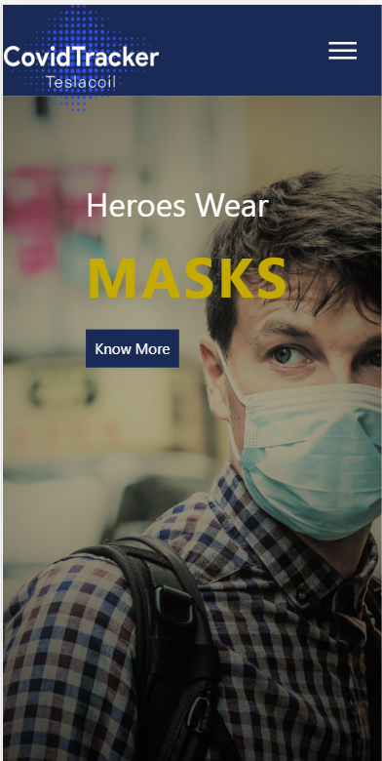
Spotlight on mobile
Here is a snapshot of our web application that have been developed in mobile view.

Slide 12
Conclusion
COVID-19 is a serious issue to the Global Health sector as well as in economy. It is very vital to make awareness among people to reduce the spread of this pandemic. On behalf of the above scenario our CovidTracker will help the people to get insights of the pandemic and strategies to remain safe. The predicted future analysis of our application will help organise to devise new strategies to fight against it.

